Slide 1
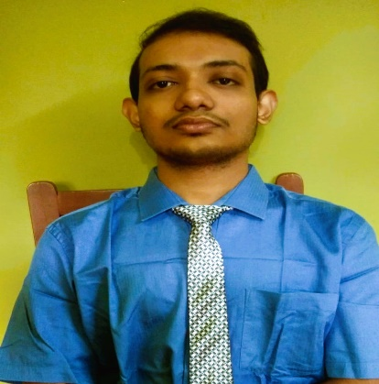






Kunal
Kundu
Full Stack Web Developer,(MERN stack), Software Engineer
CONTACT ME
EDUCATION
B-tech in Computer Science Engineering (on going) – 9.57 CGPA .
Passed X + XII from ISC with 85% aggregate in both.
Made 20+ projects on web development. Available on GitHub.
West Bengal, Kolkata - 7000145
kunalkundu427@gmail.com
Passed 10 and 12 from Holy Cross High School .
Currently perusing B-tech in CSE from Netaji Subhash Engineering College.
https://www.linkedin.com/in/kunal-kundu-2b4086223/
+91-6291395520
SKILLS
https://github.com/kunal-kundu
C++
Java
DBMS – MySQL, MongoDB
Data Structure and Algorithms
Object Oriented Programming
Operating System - Basics
Computer Networks - Basics
https://www.codingninjas.com/codestudio/profile/kunal_e9ca
https://leetcode.com/kunalkundu427/
https://www.hackerrank.com/kunalkundu427
HTML
CSS
JavaScript
React JS
Node.js
Express.js
Bootstarp, Tailwind CSS
.
Achievements
1.> Three 5* Gold batch in Problem Solving, C++ in Hacker Rank.
2.> Solved More then 400+ coding questions.
3.> 3* rating for competitive coding in CodeShef.
4.> React Certificate from
hackerrank. https://www.hackerrank.
com/certificates/603d676aec40
PROJECTS
1.> Made an Ecommerce Website(LordsOfSpice). Which delivers food at your
convenience. Tech. Used– MERN stack, context Api, JWT token,Bcrypt Js. (Please wait for 2-3mins for the application to be fully loaded.)
https://verdant-blini-e3187b.netlify.app
2.> I created a Visualizer which depicts Dijkstra Algorithm, which is used to find
the shortest path between source point and destination. Tech. Used – React Js,
JavaScript, DSA.
https://phenomenal-creponne-f8a542.netlify.app
3.> NewsMonkey is a web application, where one can read latest news of any
countries. More then 500+ daily news under 7 different categories. Tech. Used –
MERN stack, bootstrap.
https://voluble-cendol-8256d8.netlify.app
4.> MyNoteBook is a web application, where you can read and write notes from
anywhere, anytime and save them on the cloud. Your privacy is highly maintained.
Tech. Used– MERN stack,Bcrypt Js, bootstrap.
https://curious-monstera-c582ea.netlify.app
5.> Made a chrome extension using JavaScript. This extension allows you to save
as many tabs as you like. Tech. Used – JavaScript and local Storage.
https://github.com/kunalkundu/ChromeExtension/tree/9687a2d69c6ec35704e769dc4ddd7480635c46b0?search=1
Work Experience
1.> Completed Internship on Full Stack Web development from The Digital Adda. https://docs.google.com/document/d/1SM2FUWBm5kX_o8jFBEtgJvEJn1y7hkZENx2LK8cgjeA/edit?usp=sharing
2.> Intern at persistent University.
https://persistentuniversity.persistent.com/user/profile.php?id=4482

